Slide 1
Employee Attrition Predictive Analysis with Python
Ardhi Raffles

Slide 2
Outline
Introduction
Problem Statement (Use Case)
Exploratory Data Analysis (EDA)
Machine Learning
Algorithm Modeling
Choosing the Right Model
Retention Plan Strategy

Slide 3
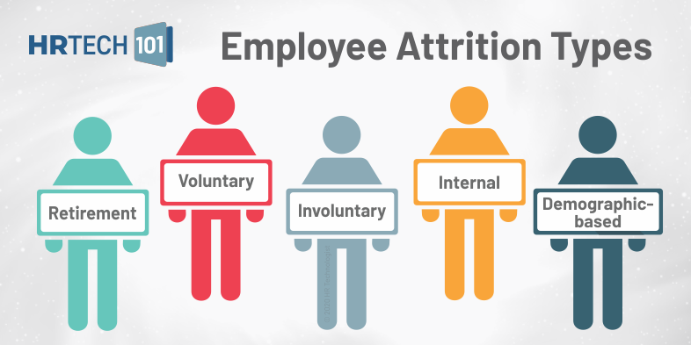
What is Employee Attrition?
“ Employee attrition is defined as the natural process by which employees leave the workforce – for example, through resignation for personal reasons or retirement – and are not immediately replaced.” -HRTech

Slide 4

Use Case
Company would like to make a Retention Plan Strategy from Employee Attrition data. What factor is really affecting employee to attrition?
Company would like to make an Employee Attrition Dashboard also a questioner to predict weather the employee are potentially attrition or loyal.

Slide 5
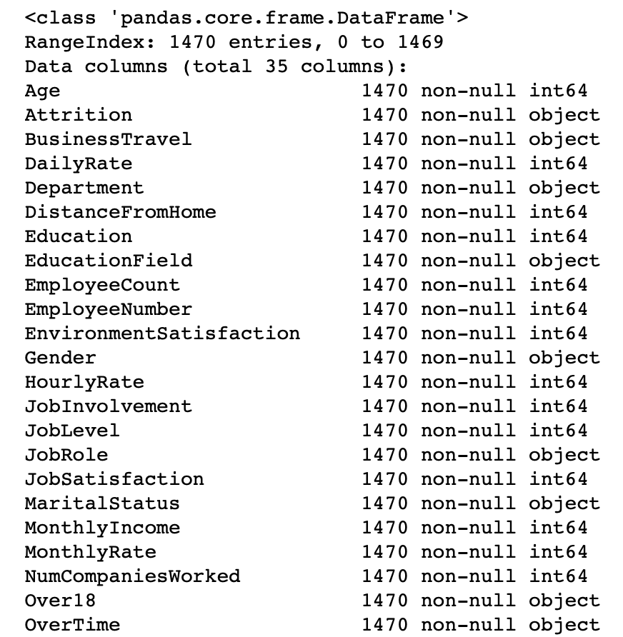
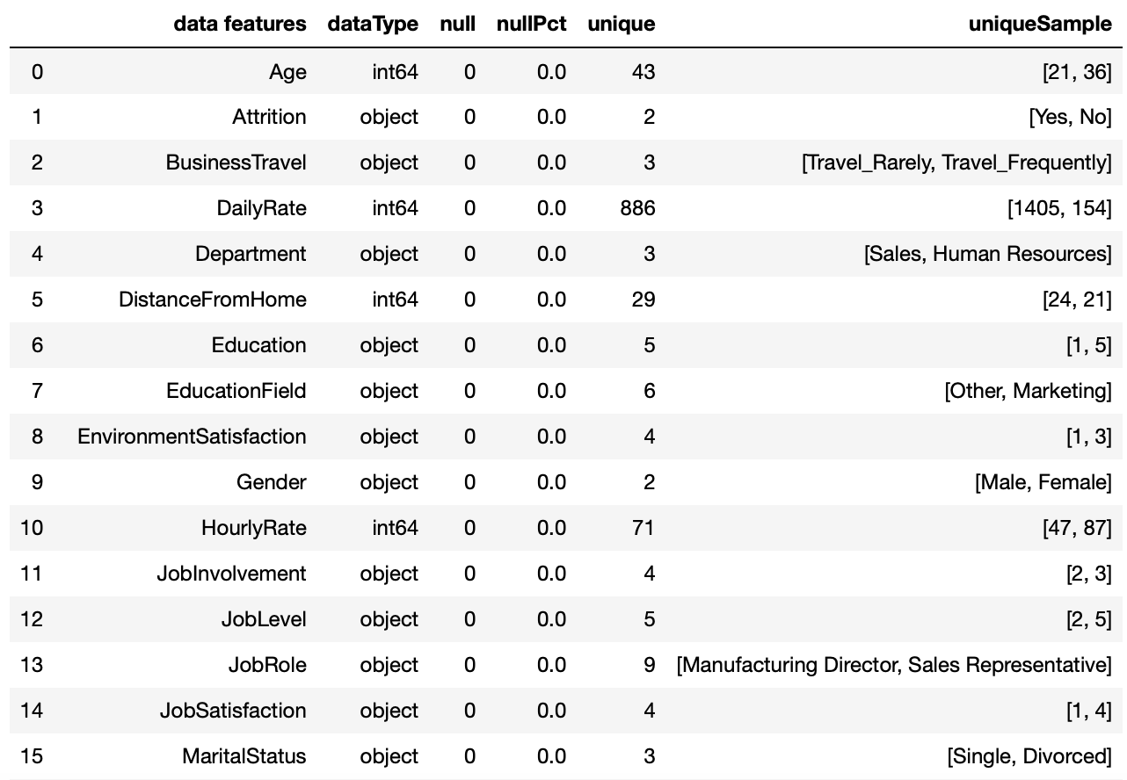
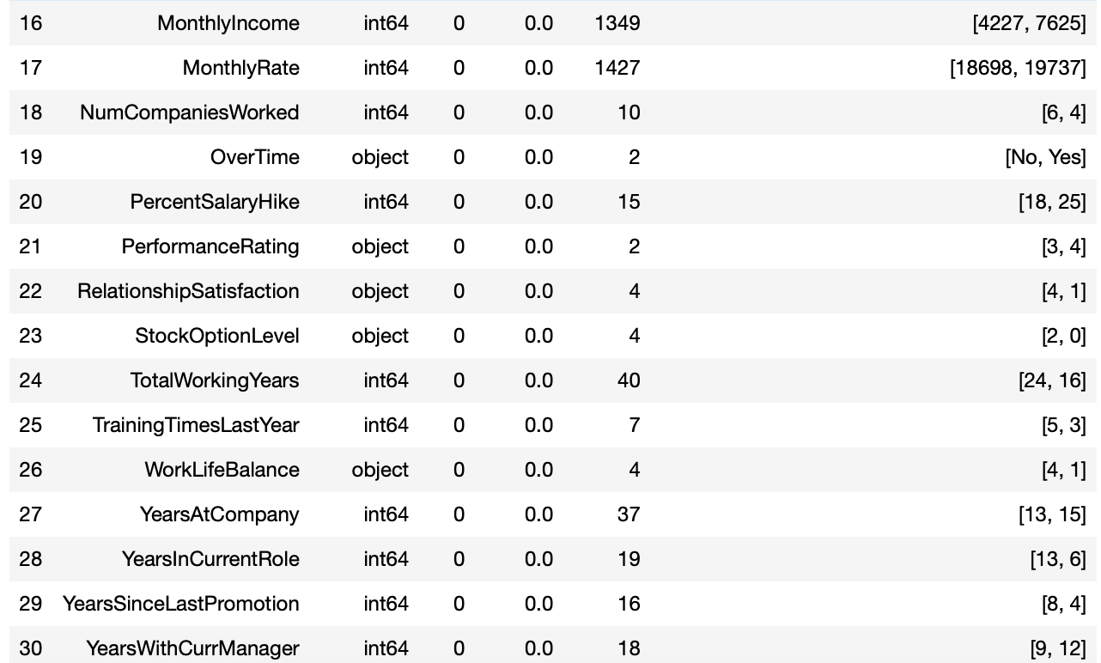
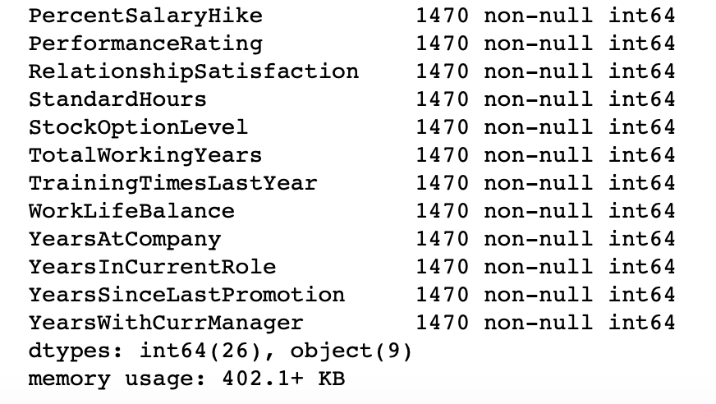
Exploratory Data Analysis
1470 Employee
35 Feature
Exploratory Data Analysis
https://www.kaggle.com/pavansubhasht/ibm-hr-analytics-attrition-dataset

Slide 6
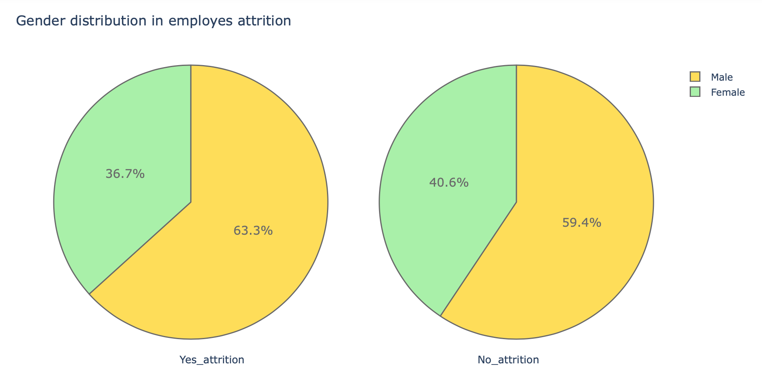
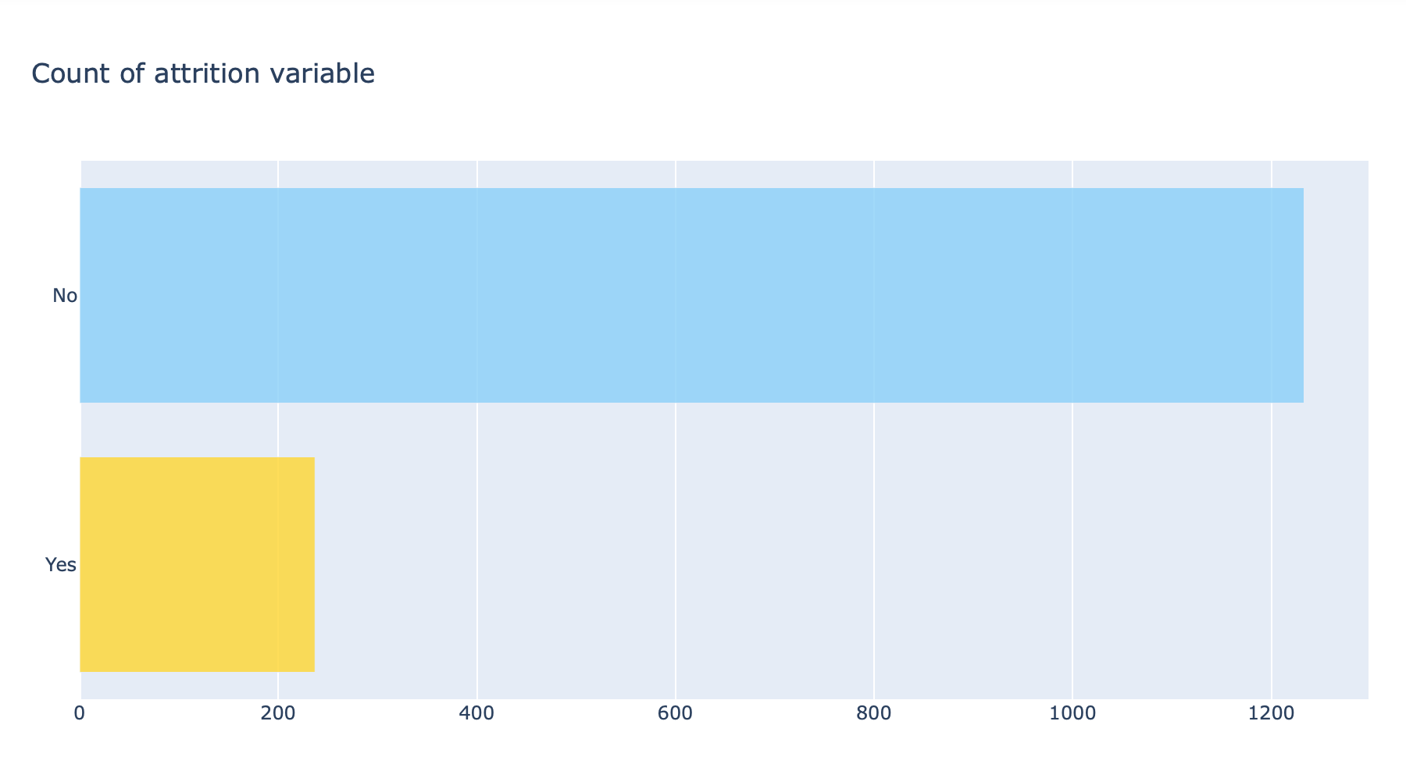
Attrition Data Analysis
Attrition Data Analysis

Slide 7
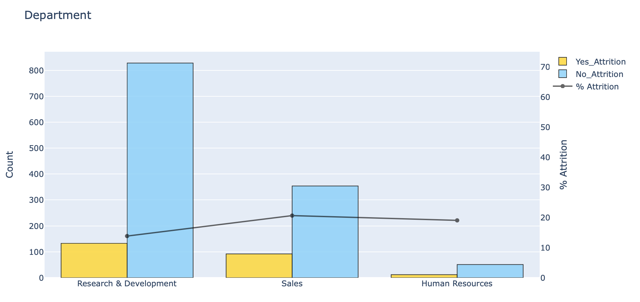
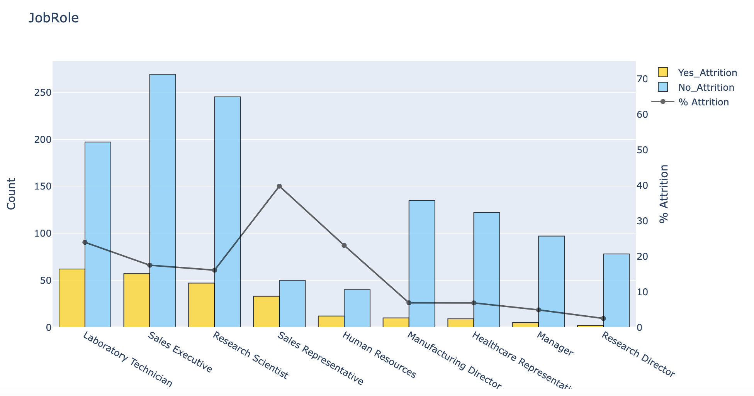
Employee Attrition Analysis (Extended)
Attrition Data Analysis

Slide 8
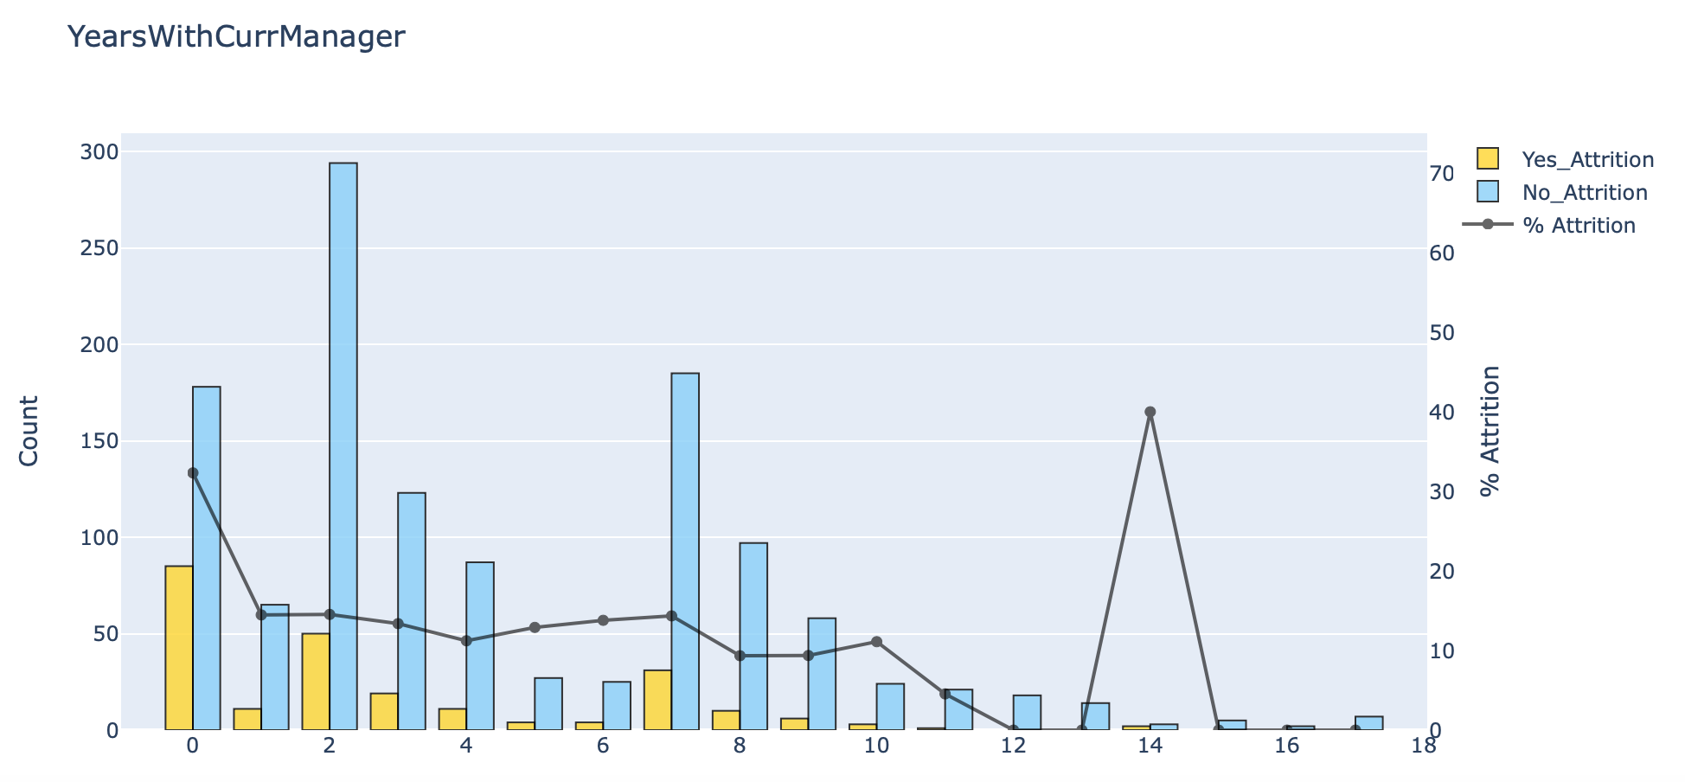
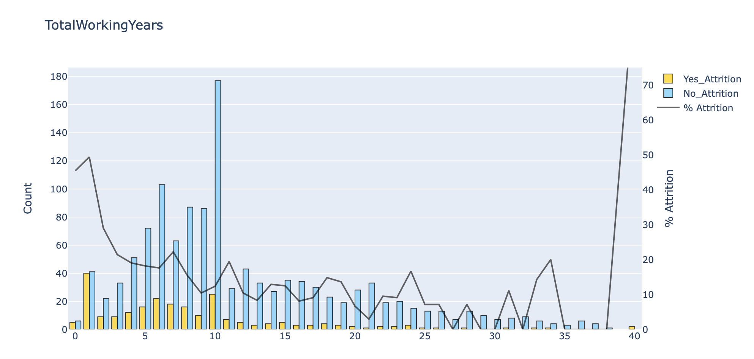
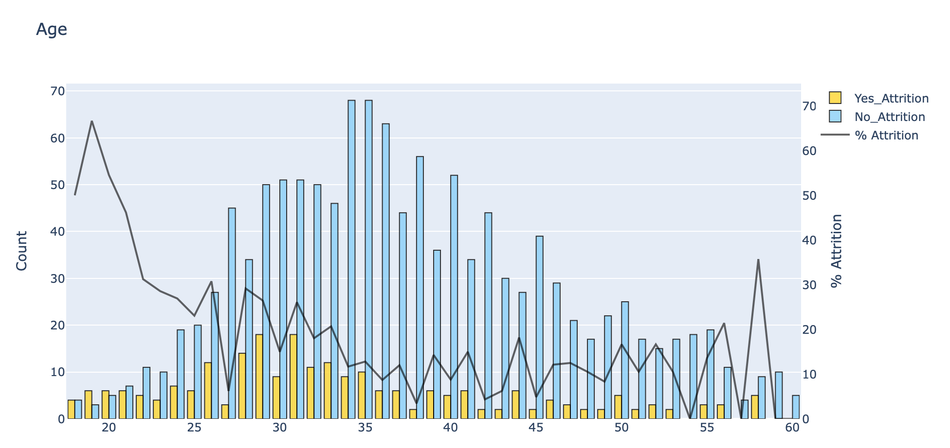
Employee Attrition Analysis (Extended)
Attrition Data Analysis

Slide 9
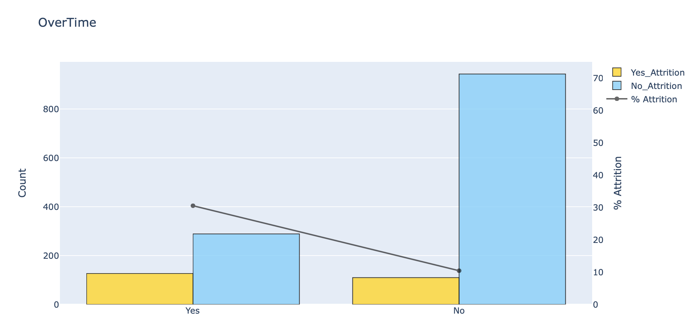
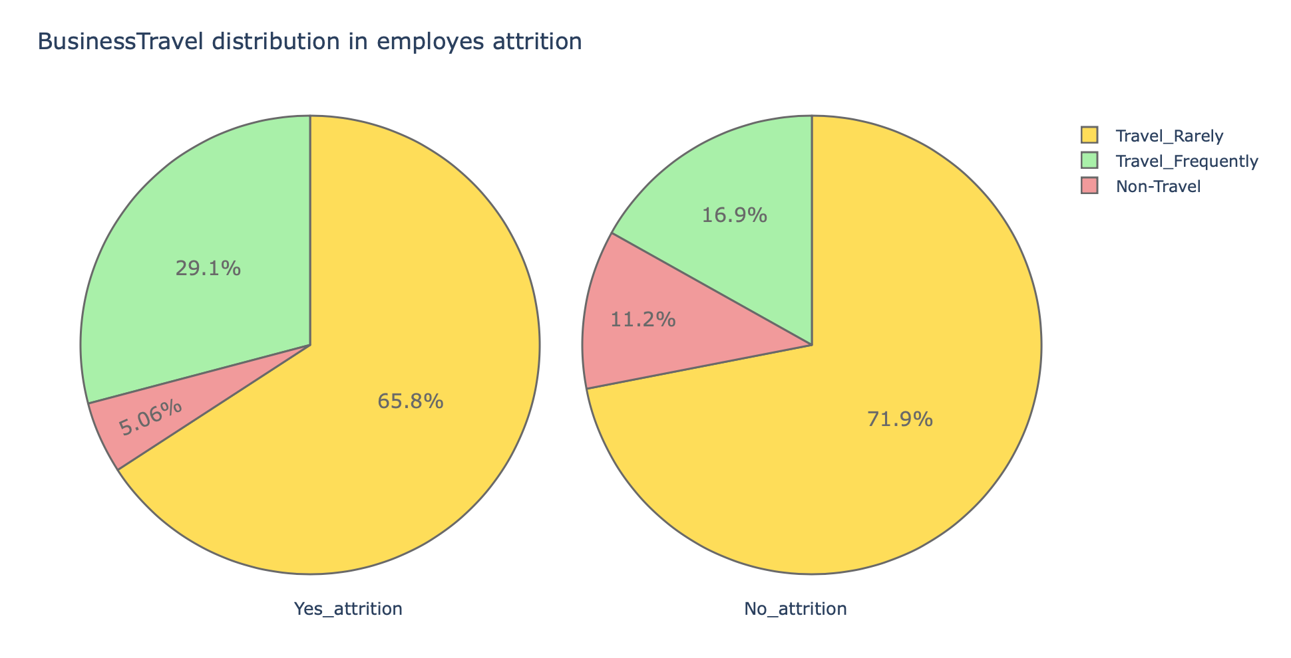
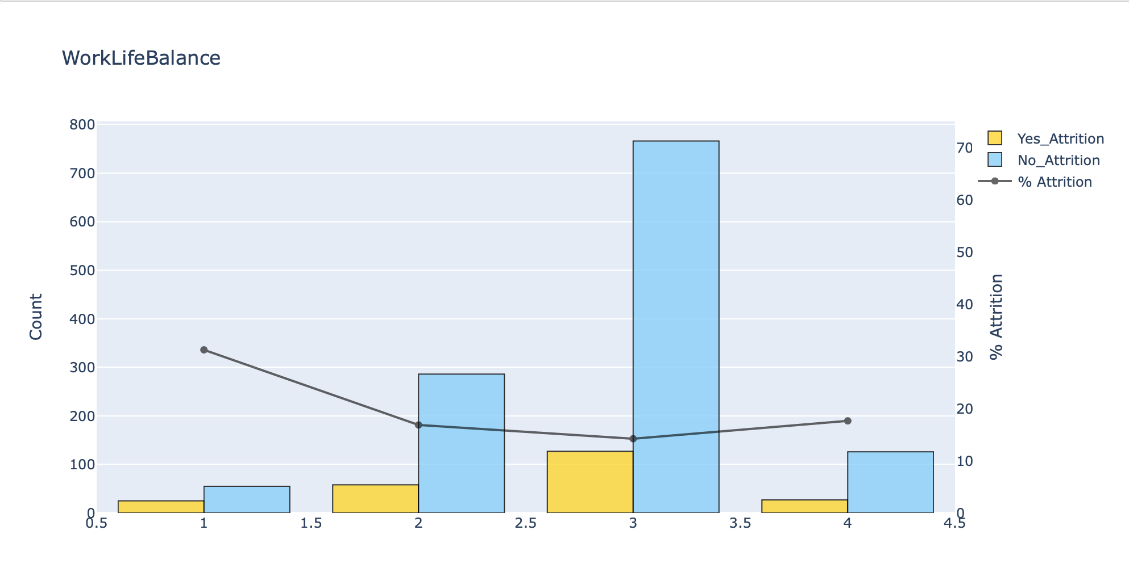
Employee Attrition Analysis (Extended)
Attrition Data Analysis

Slide 10
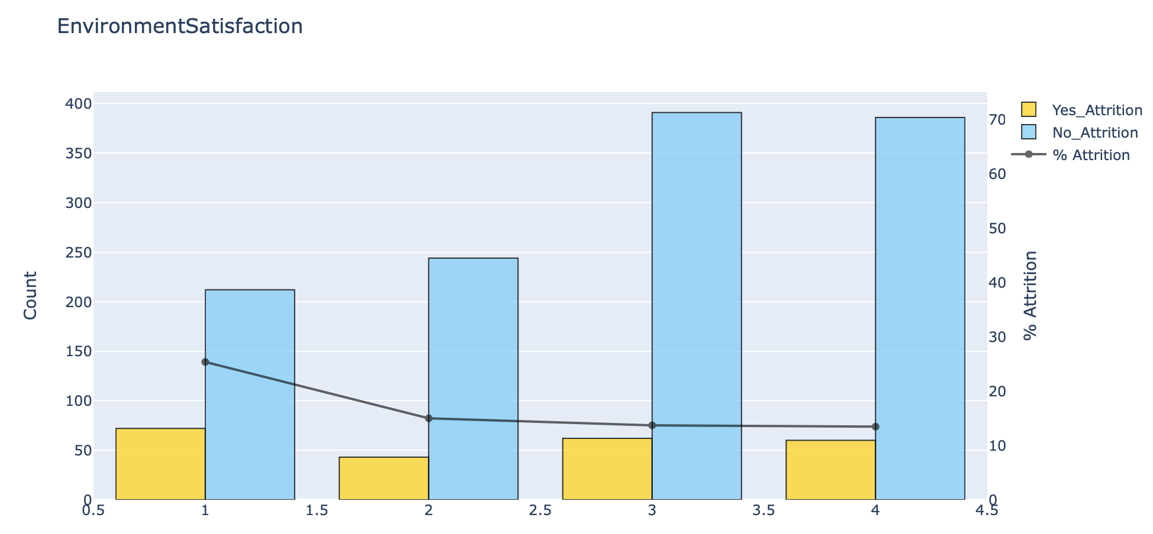
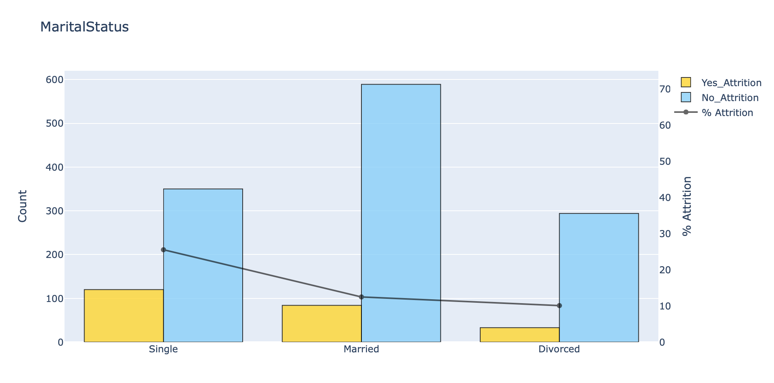
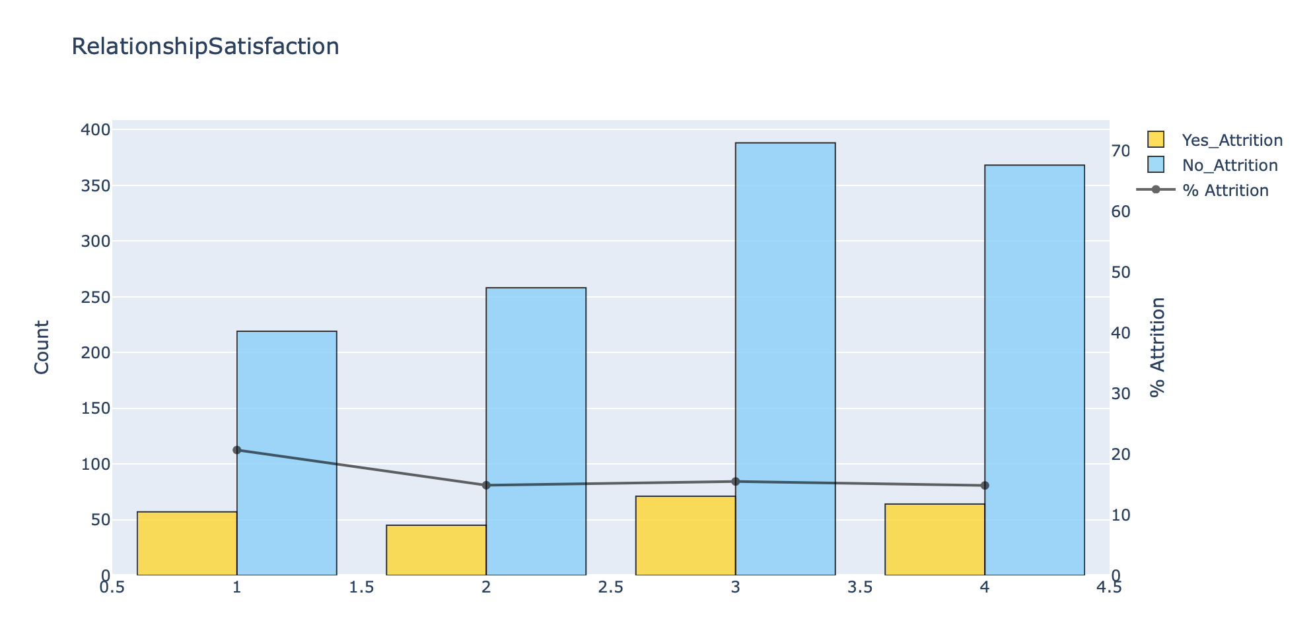
Employee Attrition Analysis (Extended)
Attrition Data Analysis

Slide 11
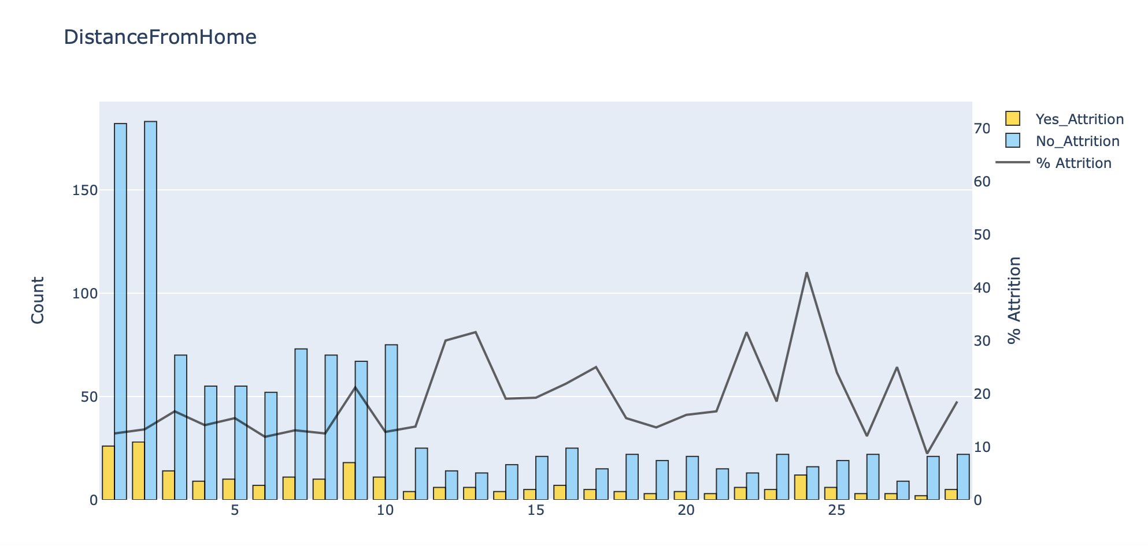
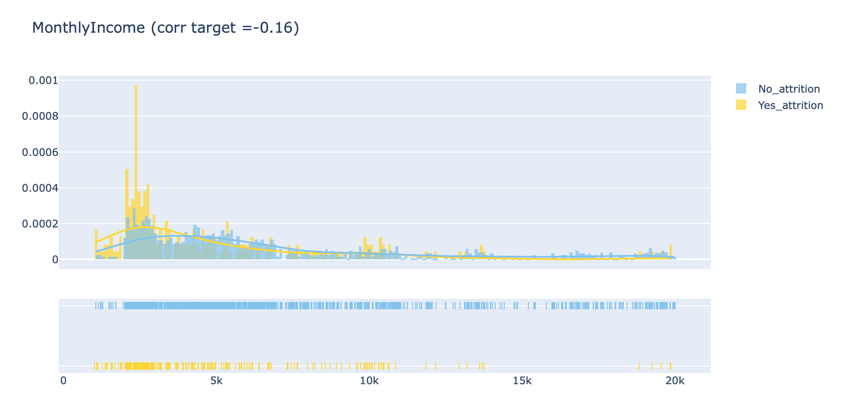
Employee Attrition Analysis (Extended)
Attrition Data Analysis

Slide 12
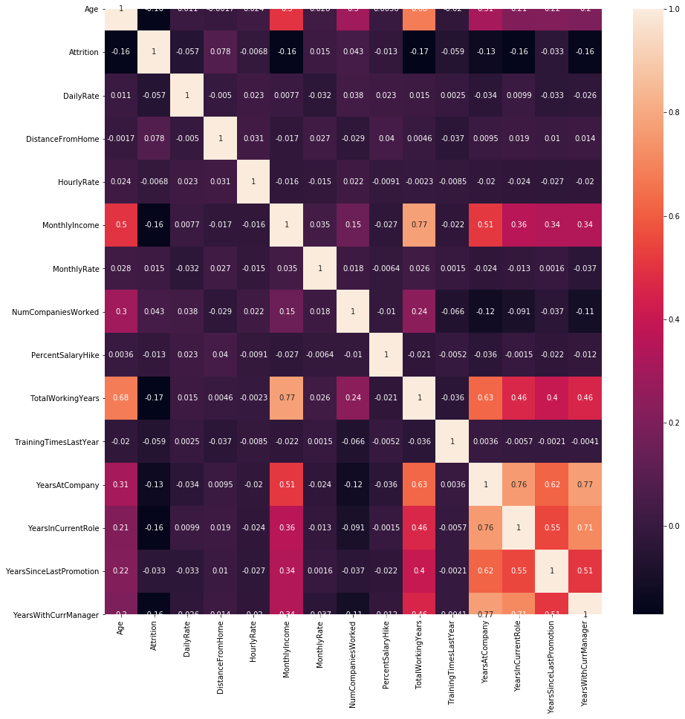
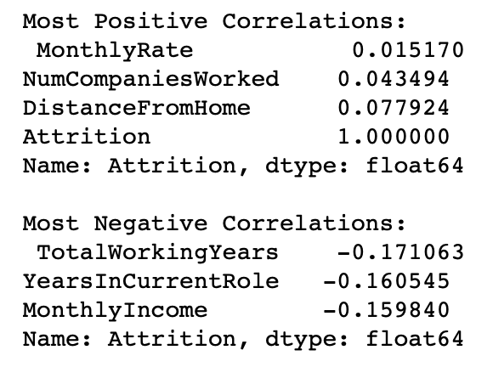
Feature Correlation Heatmap (Pearson)

Slide 13

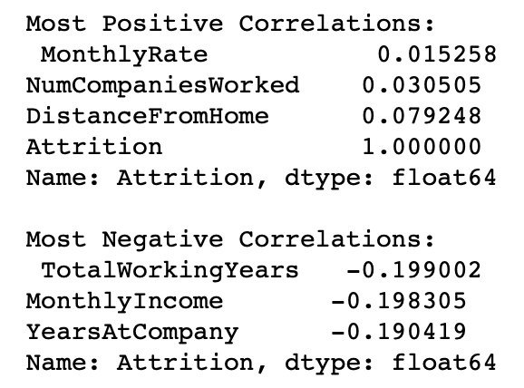
Feature Correlation Heatmap (Spearman)

Slide 14
Attrition Predictor Machine Milestone
Data Preparation
Data Modeling
Model Evaluation
Choosing Model

Slide 15
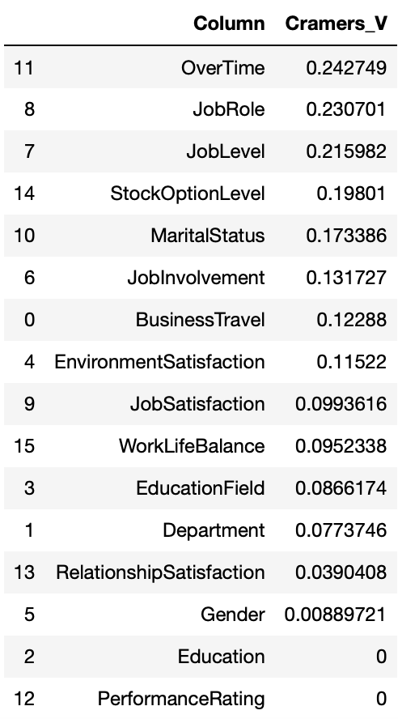
Cramer’s V Test
Most correlated Categorical column with Attrition Column:
Categorical Columns vs Attrition
OverTime
JobRole
JobLevel
StockOptionLevel
MaritalStatus
Step 1 Data Preparation

Slide 16
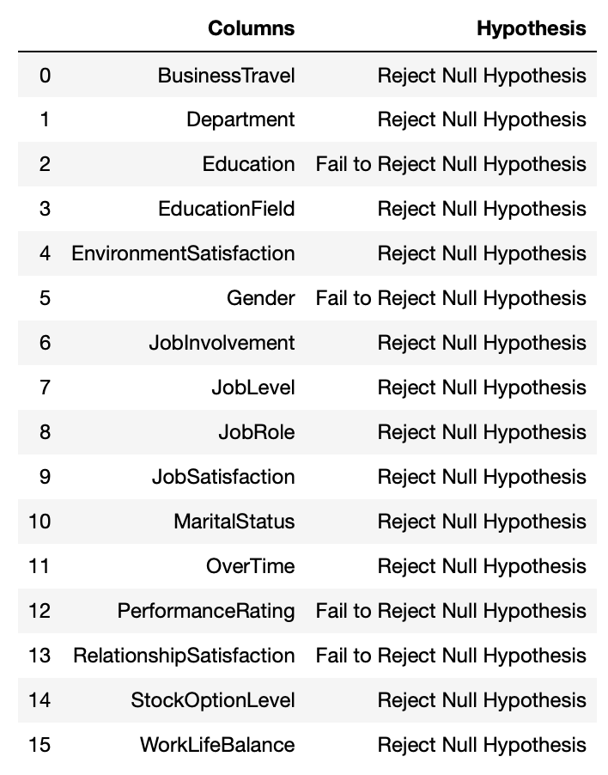
Hypothesis Testing
Chi Square
Categorical Columns vs Attrition
H0 = There is no relationship between variable one and variable two.
H1 = There is a relationship between variable 1 and variable 2.
Step 1 Data Preparation

Slide 17
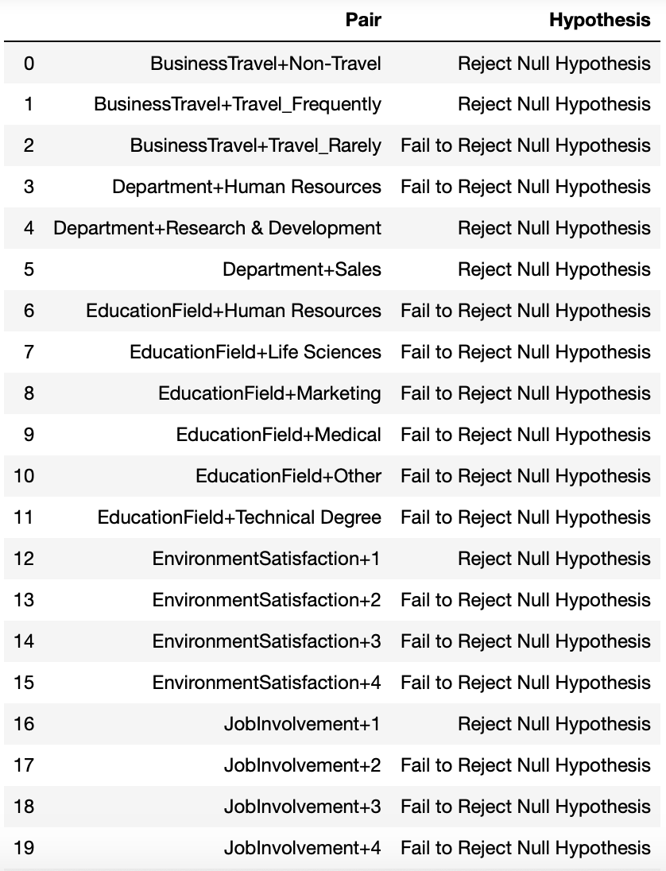
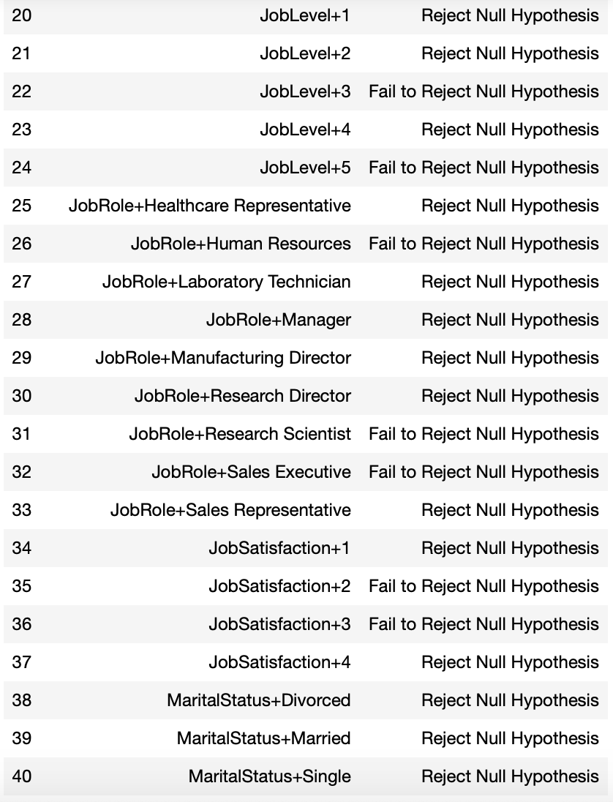
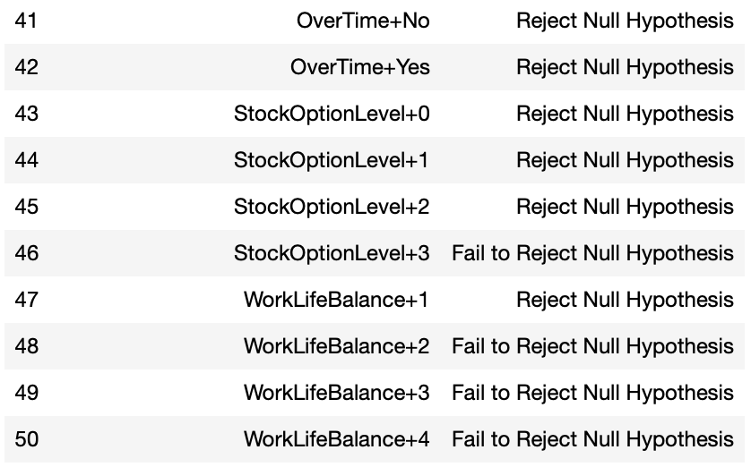
Post Hoc Test Categorical Column vs Attrition
Step 1 Data Preparation

Slide 18
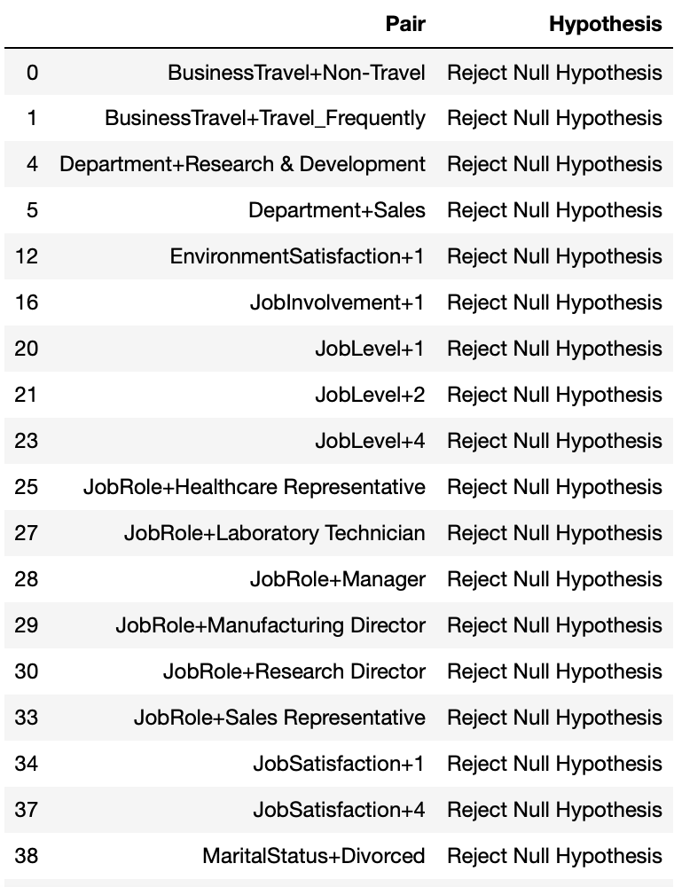
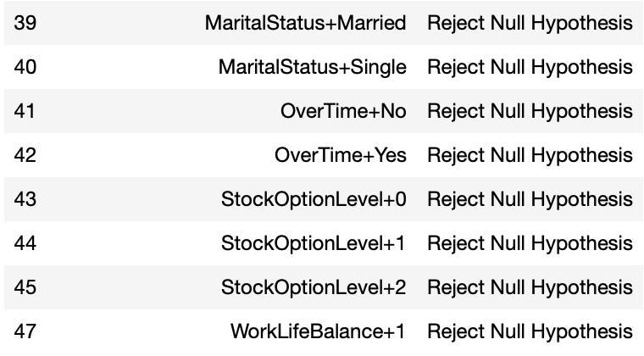
Post Hoc Test Categorical Column vs Attrition (H1 Sorted)
Step 1 Data Preparation

Slide 19
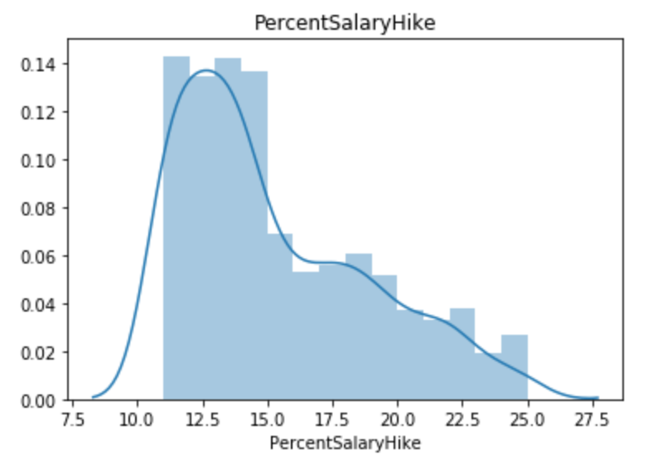
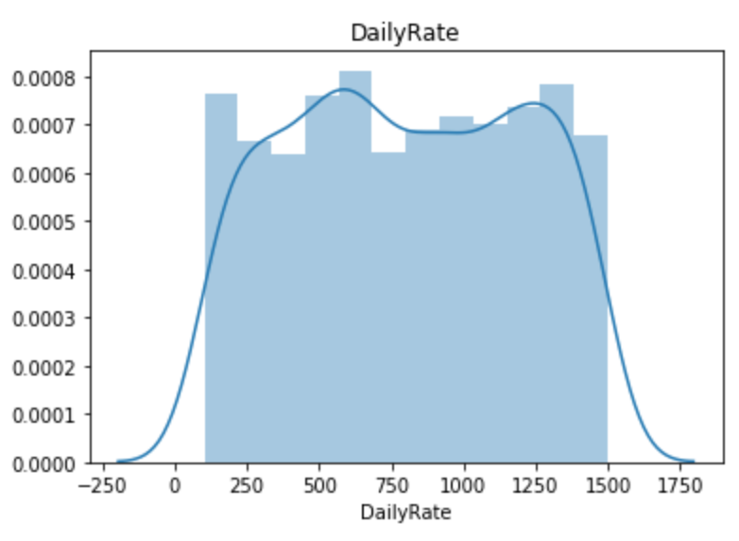
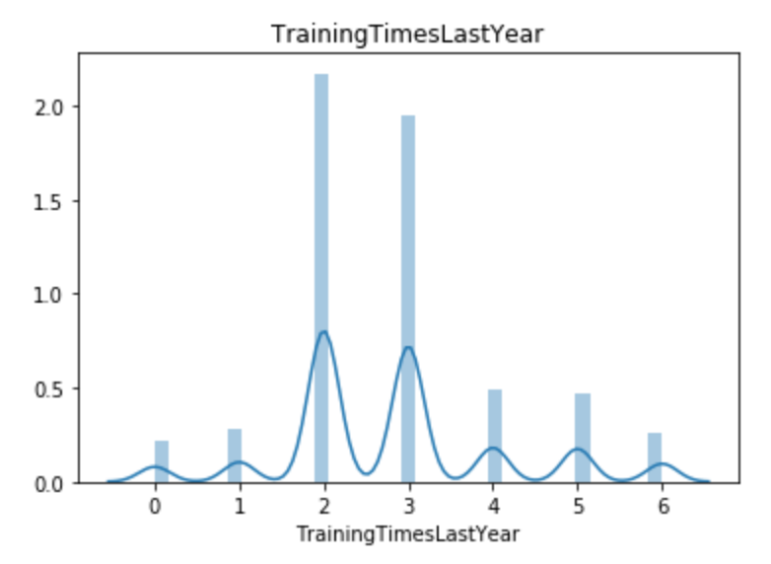
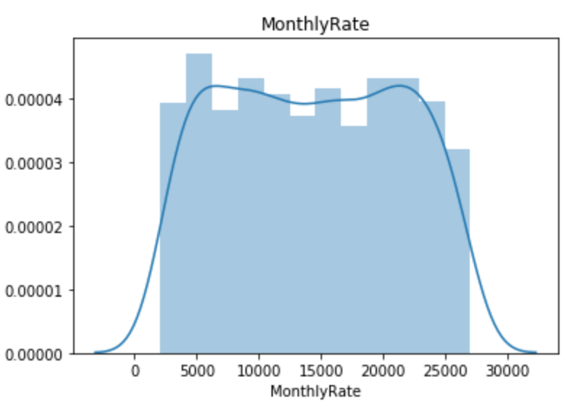
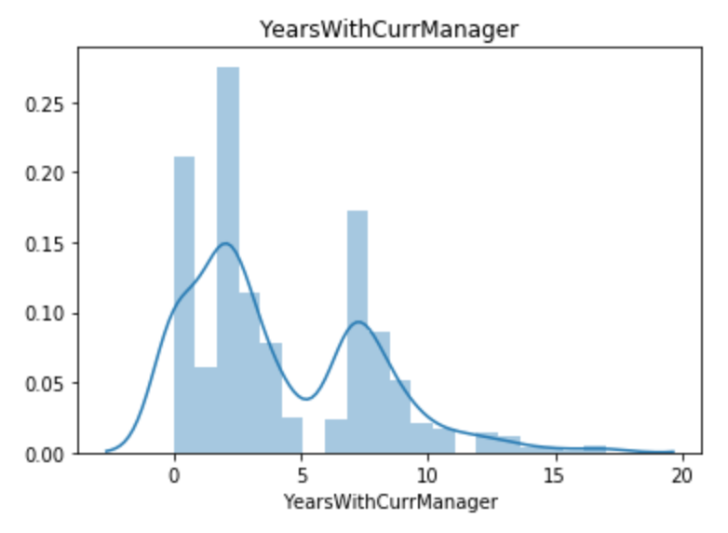
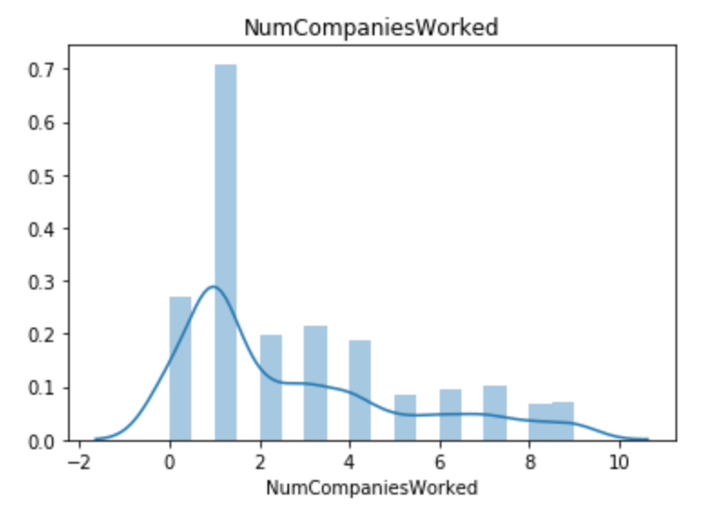
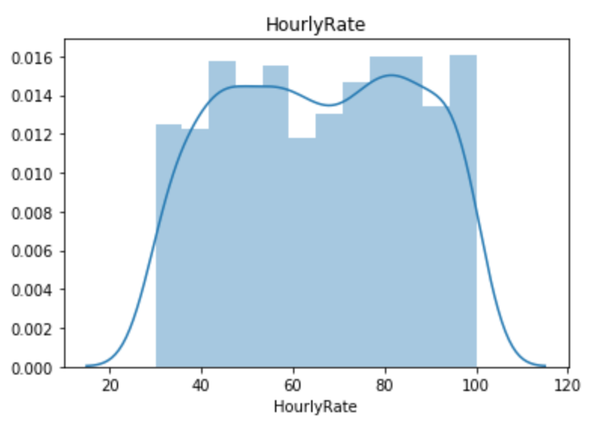
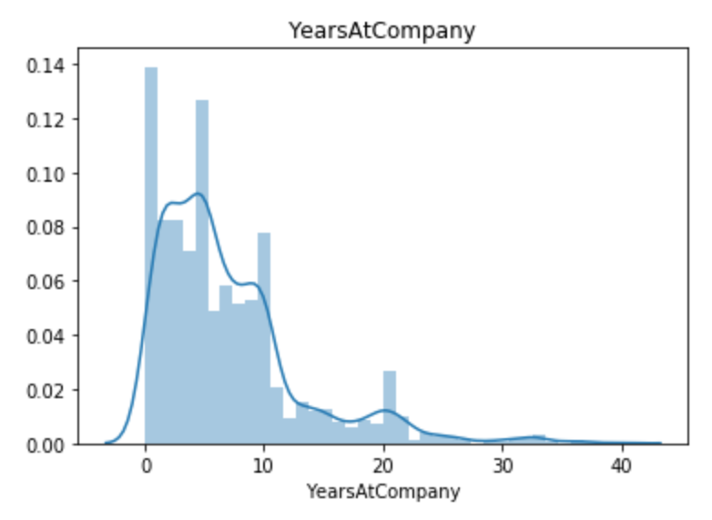
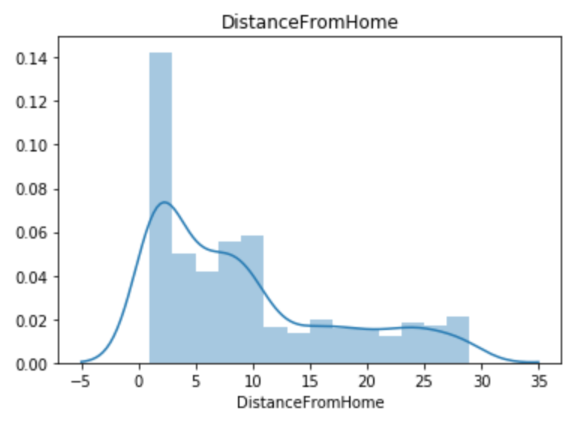
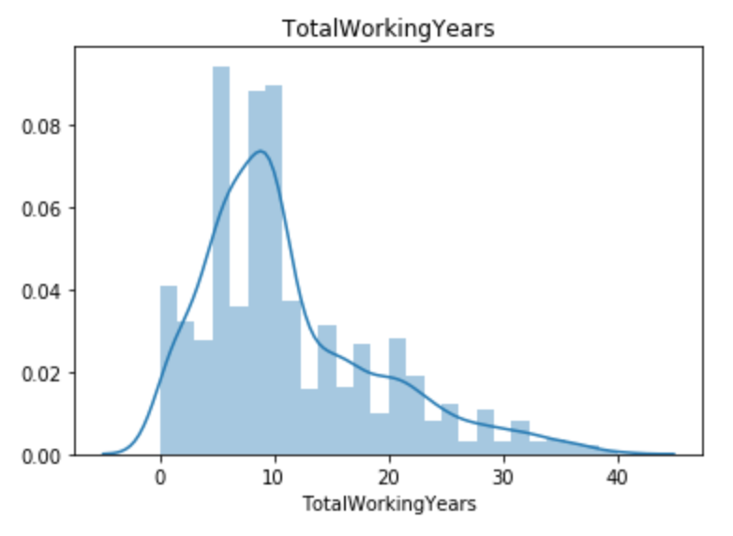
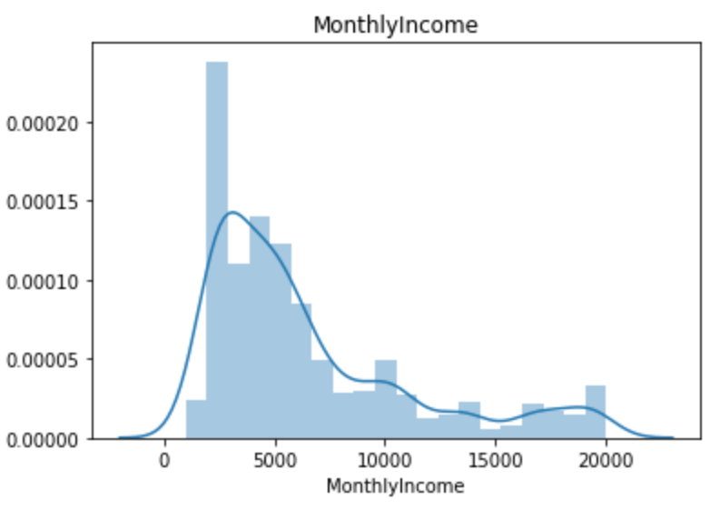
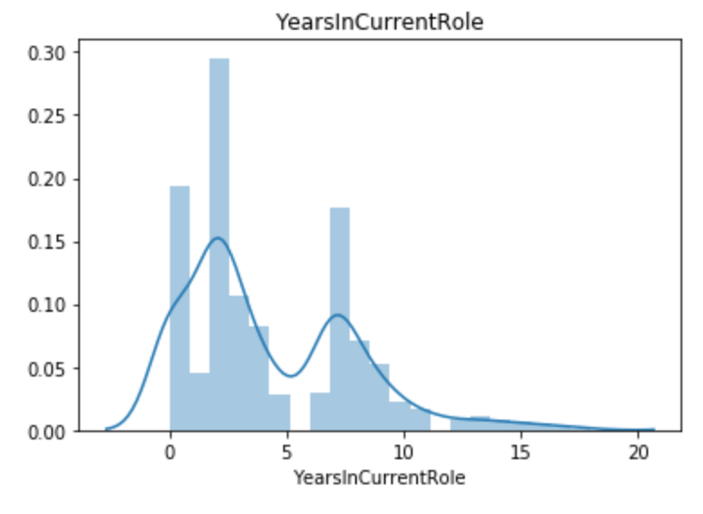
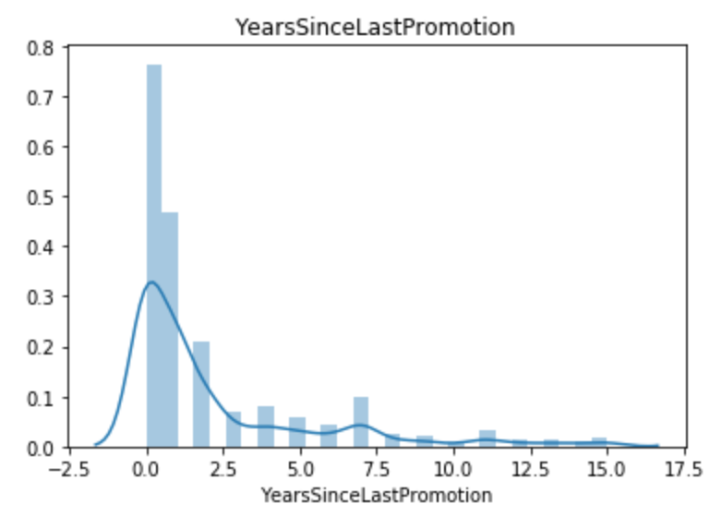
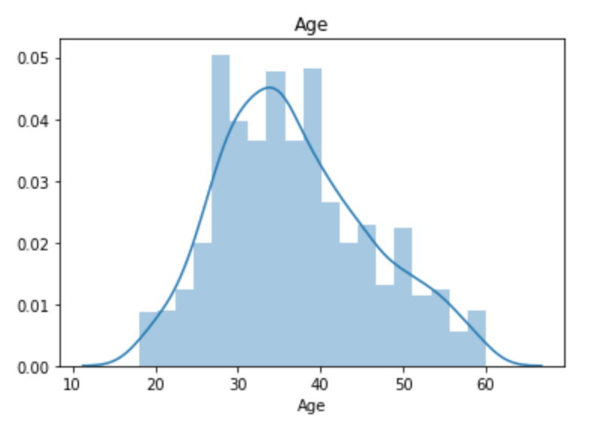
Continuous Data Distribution Graphic
Step 1 Data Preparation

Slide 20
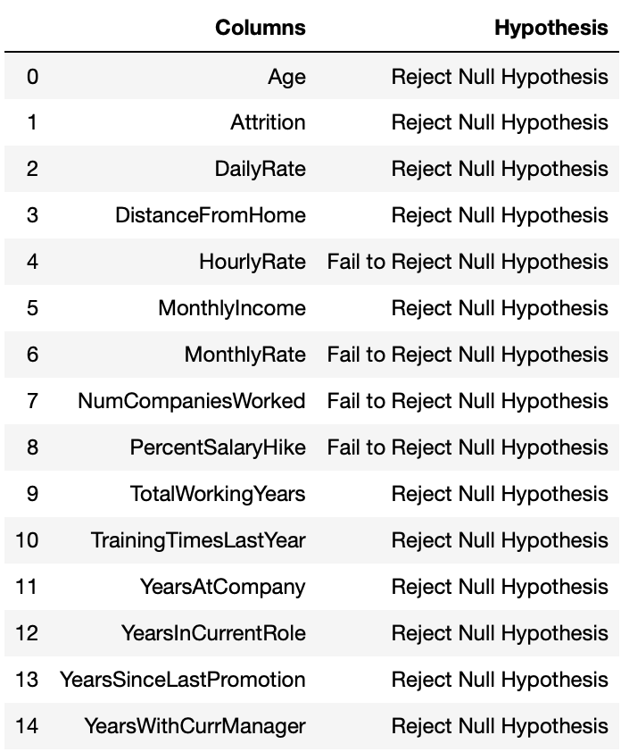
Hypothesis Testing
Mannwhitneyu (Continuous Column Test)
H0 = There is no relationship between variable one and variable two.
H1 = There is a relationship between variable 1 and variable 2.
Step 1 Data Preparation

Slide 21
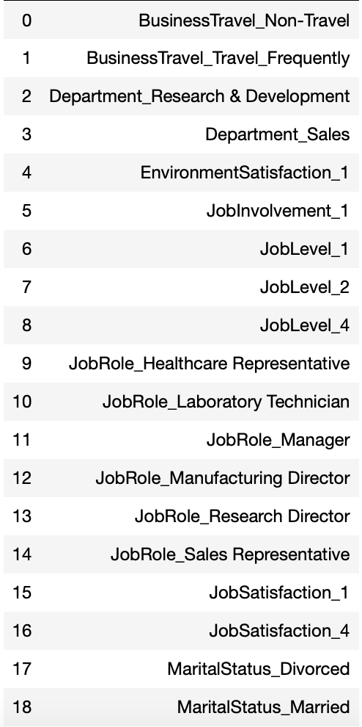
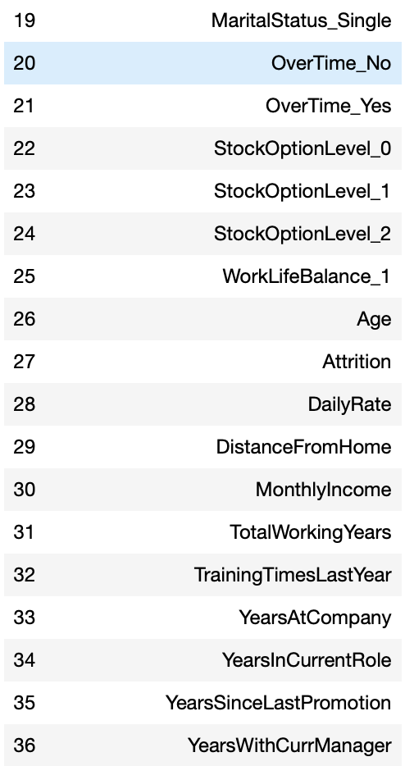
Significant Columns
Continuous & Categorical Data
Step 1 Data Preparation

Slide 22
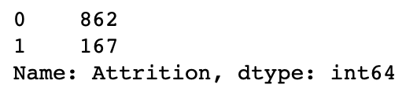

Data Preprocessing
Data Splitting (Train & Test)
SMOTE Oversampling
Feature Scaling
For K-NN model only.
PCA
70% Train & 30% Test
Step 1 Data Preparation

Slide 23
Modeling
Evaluation
Strategy
Logistic Regression
Decision Tree Classification
Random Forest Classification
AdaBoost
Gradient Boosting
XGBoost
K - Nearest Neighbour
Auto ML
Confusion Matrix
Classification Report
Accuracy Score
Matthews Correlation Coefficient Score
Log Loss
ROC & AUC Score
K - Fold CV
&
Modeling
Normal Data
Oversampled Data
Evaluation
Grid Search Result
Step 2 Data Modeling

Slide 24
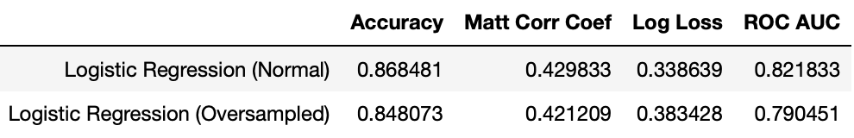
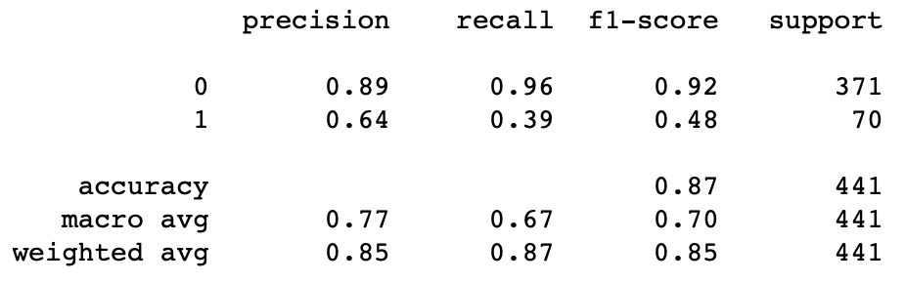


Logistic Regression
Classification Report Logistic Test (Normal Data)
Classification Report Logistic Test (Oversampled Data)
K-Fold CV Result
Step 2 Data Modeling

Slide 25





Decision Tree Classifier
Classification Report Decision Tree (Normal Data)
Classification Report Decision Tree (Normal GS)
Classification Report Decision Tree (Oversampled Data)
Classification Report Decision Tree (Oversampled GS)
Step 2 Data Modeling

Slide 26

K-Fold CV Decision Tree
Step 2 Data Modeling

Slide 27





Random Forrest
Classifier
Classification Report RFC (Normal Data)
Classification Report RFC (Normal GS)
Classification Report RFC (Oversampled Data)
Classification Report RFC (Oversampled GS)
Step 2 Data Modeling

Slide 28

K-Fold CV Random Forest Classifier
Step 2 Data Modeling

Slide 29





Adaptive Boosting Classifier
Classification Report AdaBoost (Normal Data)
Classification Report AdaBoost (Normal GS)
Classification Report AdaBoost (Oversampled Data)
Classification Report AdaBoost (Oversampled GS)
Step 2 Data Modeling

Slide 30

K-Fold CV AdaBoost Classifier
Step 2 Data Modeling

Slide 31





Gradient Boosting
Classifier
Classification Report Gradient Boosting (Normal Data)
Classification Report Gradient Boosting (Normal GS)
Classification Report Gradient Boosting (Oversampled Data)
Classification Report Gradient Boosting (Oversampled GS)
Step 2 Data Modeling

Slide 32

K-Fold CV Gradient Boosting
Step 2 Data Modeling

Slide 33





XGBoost
Classifier
Classification Report XGBoost (Normal Data)
Classification Report XGBoost (Normal GS)
Classification Report XGBoost (Oversampled Data)
Classification Report XGBoost (Oversampled GS)
Step 2 Data Modeling

Slide 34

K-Fold CV XGBoost
Step 2 Data Modeling

Slide 35





K-Nearest Neighbor
Classifier
Classification Report KNN(Normal Data)
Classification Report KNN (Oversampled Data)
Step 2 Data Modeling

Slide 36

K-Fold CV K-Nearest Neighbor
Step 2 Data Modeling

Slide 37


Auto ML
Normal Data - Gradient Boosting
Step 2 Data Modeling

Slide 38



Auto ML
Oversampled Data - Gradient Boosting
Step 2 Data Modeling

Slide 39


Summary All Classification Model Result
Best Accuracy Result:
XGBoost (Normal Data) Grid Search = 87.98%
AdaBoost (Normal Data) Grid Search = 87.52%
Logistic Regression (Normal Data) = 86.84%
Step 3 Model Evaluation

Slide 40


Feature Importance
XGBoost
(Normal Data) Grid Search Accuracy = 87.98%
From XGBoost F Score
Permutation Importance
Step 3 Model Evaluation

Slide 41








Choosing the Right Model Classification
Logistic Regression
Classifier
(Oversampled Data)
Adaptive Boosting
Classifier
(Oversampled Data)
Gradient Boosting
Classifier
(Oversampled Data)
Step 4 Choosing Model

Slide 42
Strategy to Retention Plan
Over Time & Work Life Balance
Age
Total Working Year
Years at Company
Years with Current Manager
Monthly Income
Job Role
Distance from Home

Slide 43








Over Time & Work Life Balance
Years with Current Manager
Employee who overtime and don’t have good work life balance are potentially attrition.
Many employee resign after 6-12 month with their manager.
Age
Monthly Income
Employee who is young (between 18 – 22) are potential for attrition.
Employee with smaller income had a bigger potential for attrition.
Total Working Year
Job Role
Young employee who have lack of experience are potential for attrition.
Job Role from Sales Department had a bigger potential for attrition .
Years at Company
Distance from Home
Normally if the employee survive for at least 5 years, the potential of attrition are decrease.
Employee who works further from home are potential for attrition.

Slide 44
Thank You.
End of Presentation

